Slide 1

DRUG TRACEABLITY

Slide 2
INTRODUCTION
REVOLUTIONIZING DRUG TRACEABILITY
Leveraging the power of block chain technology. This presentation will explore the potential of block chain technology to transform the drug traceability process, providing greater transparency, security and efficiency. The pharmaceutical supply chain is complex and vulnerable to fraud and counterfeit drugs. Blockchain technology can provide an immutable and transparent solution to secure the supply chain and ensure drug traceability.

Slide 3
DEFINITION
It is the process of determining the product's authenticity and originality so that all stakeholders can track and trace transactions at every level of the supply chain.
CHALLENGES
Its process is plagued by inefficiencies, fraud and counterfeiting. Lack of transparency in the supply chain and difficulty in tracking products ,time-consuming and prone to errors are major challenges.

Slide 4
TOOLS AND TECHNOLOGY USED
Different approaches have been proposed to solve drug counterfeiting and improve pharmaceutical traceability including the use of the “ETHEREUM BLOCKCHAIN AND DISTRIBUTED LEDGER TECHNOLOGIES” to manage the supply chain.
Block chain technology can create a tamperproof, transparent and secure record of drug transactions. Each transaction is recorded in a decentralized, immutable ledger, providing an unprecedented level of transparency. Block chain can also enable real-time tracking of drugs, reducing the risk of counterfeit products.

Slide 5


Slide 6
IMPLEMENTATION OF BLOCKCHAIN
Blockchain in technology can be used to create a secure and transparent drug traceability system. Each drug can be assigned a unique identifier that is recorded on the blockchain. The Drug’s journey through the supply chain can be tracked and verified using the blockchain. This ensures that the drug is authentic has not been tampered with. Implement SMART CONTRACTS for automated verification. This can define rules and conditions for transactions and it ensures that a distributor can only accept products from a licensed manufacturer.

Slide 7
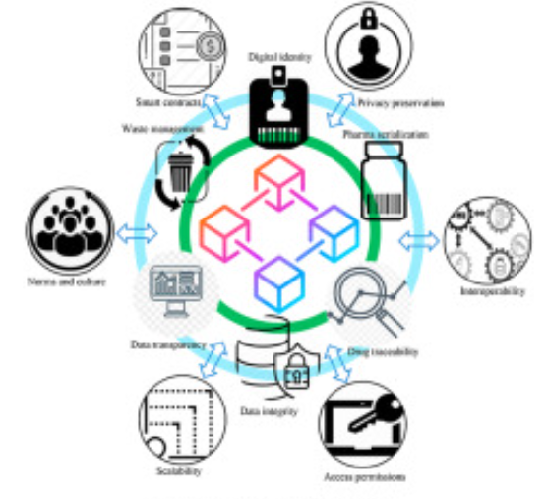

Slide 8
CURRENT APPLICATIONS OF BLOCKCHAIN IN DRUG TRACEABILITY
Several companies are already using block chain to improve drug traceability. IBM and WALMART are collaborating on a block chain-based system to track food and drug shipments chronicled is using blockchain to track pharmaceuticals in the supply chain. Block verify is using blockchain to verify the authenticity of drugs.

Slide 9
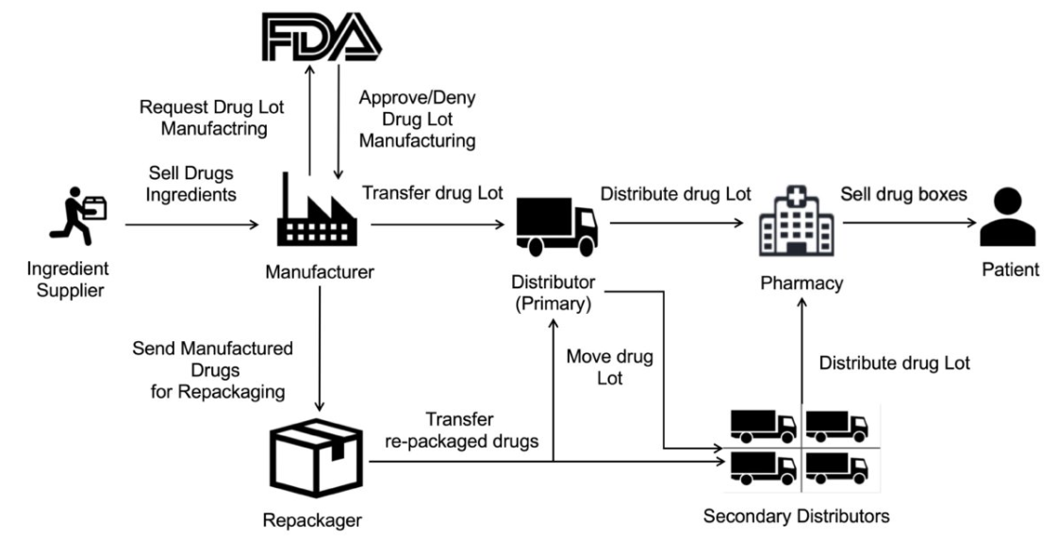

Slide 10
CONCLUSION
Block chain technology has the potential to revolutionize drug traceability by providing greater transparency , security and efficiency while there are still challenges to be overcome , several companies are already using blockchain to improve the drug traceability process. As blockchain technology continues to evolve, we can expect to see more innovative solutions in the future.

